Slide 1
Machine Learning
Outline:
Introduction to machine learning
Unsupervised learning
Supervised learning

Slide 2
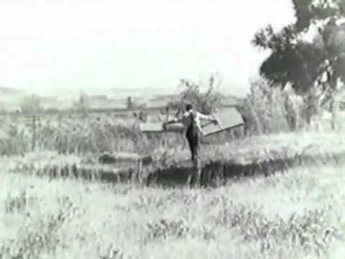
What is Machine Learning about?
2
To enable machines to learn and adapt without explicitly programming them
Our only frame of reference for learning is from biology
…but brains are hideously complex, the result of ages of evolution
Like much of AI, Machine Learning mainly takes an engineering approach¹
Remember, humanity didn’t master flight by just imitating birds! ☺
^{1.}
Although there is occasional biological inspiration

Slide 3
Theoretical Foundations
Mathematical foundations borrowing from several areas
Statistics (theories of how to learn from data)
Optimization (how to solve such learning problems)
Computer Science (efficient algorithms for this)
This intro lecture will focus more on intuitions than mathematical details
ML also overlaps with multiple areas of engineering, e.g.
Computer vision
Natural language processing (e.g. machine translation)
Robotics, signal processing and control theory
...but traditionally differs by focusing more on data-driven models and AI

Slide 4
Why Machine Learning
Difficulty in manually programming agents for every possible situation
The world is ever changing, if an agent cannot adapt, it will fail
Many argue learning is required for Artificial General Intelligence (AGI)
We are still far from human-level general learning ability…
…but the algorithms we have so far have shown themselves to be useful in a wide range of applications!
Using just data, recent “deep learning” approaches can come near human performance on many problems, but near may not always be sufficient

Slide 5
When Is Machine Learning Useful Today?
While not as data-efficient as human learning, once an AI is “good enough”, it can be cheaply duplicated
Computers work 24/7 and you can usually scale throughput by piling on more of them
Software Agents (Apps and web services)
Companies collect ever more data and processing power is cheap (“Big data”)
Can let an AI learn how to improve business, e.g. smarter product recommendations, search engine results, ad serving, to decision support
Can sell services that traditionally required human work, e.g. translation, image categorization, mail filtering, content generation…?
Hardware Agents (Robotics)
Although data is more extensive, many capabilities that humans take for granted like locomotion, grasping, recognizing objects, speech have turned out to be difficult to manually construct rules for.

Slide 6
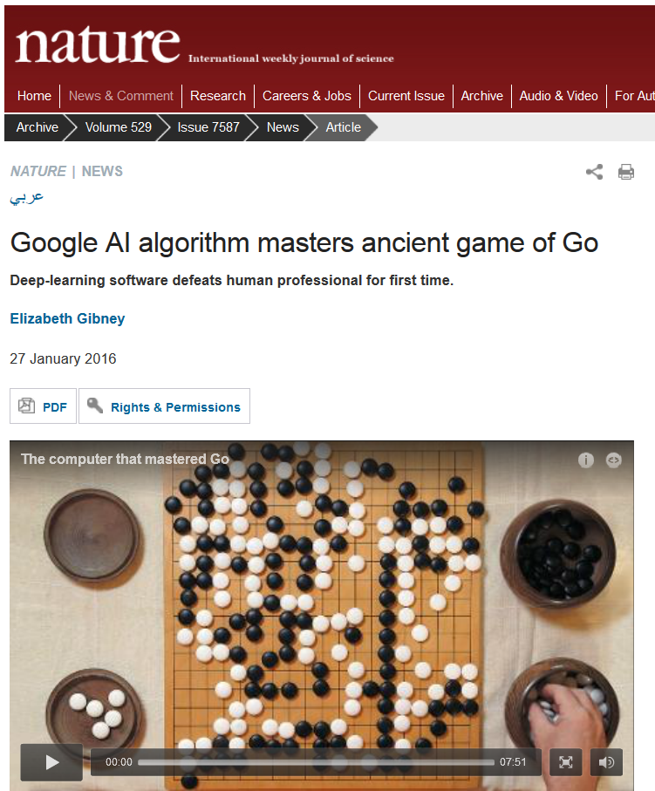
Example – Google Deepmind’s Go Agent
However, in narrow applications machine learning can rival or beat human performance.

Slide 7
Algorithmic, Knowledge-Based and Learning-Based AI
AI-program written by programmers
Knowledge added by domain experts
Training data added by domain experts
General solver written by programmers
General learning system written by programmers
Computer
Computer
Computer
Algorithmic
Knowledge-based
Learning-based
(Pattern-based)
Fredrik Heintz - Machine Learning

Slide 8
To Define Machine Learning
Given a task, mathematically encoded via some performance metric, a machine can improve its performance by learning from experience (data)
From the agent perspective:
Performance Metric
Input (Sensors)
Agent
World
Output (Actuators)
Notes:
To tie into earlier lectures we will borrow the agent framework to illustrate the usefulness of machine learning to AI.
To make this picture clearer we will look closer at different types of learning.
Agent: hardware or software, very abstract

Slide 9
To Define Machine Learning
Arthur Samuel (1959). Machine Learning: Field of study that gives computers the ability to learn without being explicitly programmed.
Tom Mitchell (1998) Well-posed Learning Problem: A computer program is said to learn from experience E with respect to some task T and some performance measure P, if its performance on T, as measured by P, improves with experience E.
Suppose your email program watches which emails you do or do not mark as spam, and based on that learns how to better filter spam.
Experience E is Watching you label emails as spam or not spam.
Task T is Classifying emails as spam or not spam.
Performance P is The number (or fraction) of emails correctly classified as spam/not spam.
Notes:
To tie into earlier lectures we will borrow the agent framework to illustrate the usefulness of machine learning to AI.
To make this picture clearer we will look closer at different types of learning.
Agent: hardware or software, very abstract

Slide 10
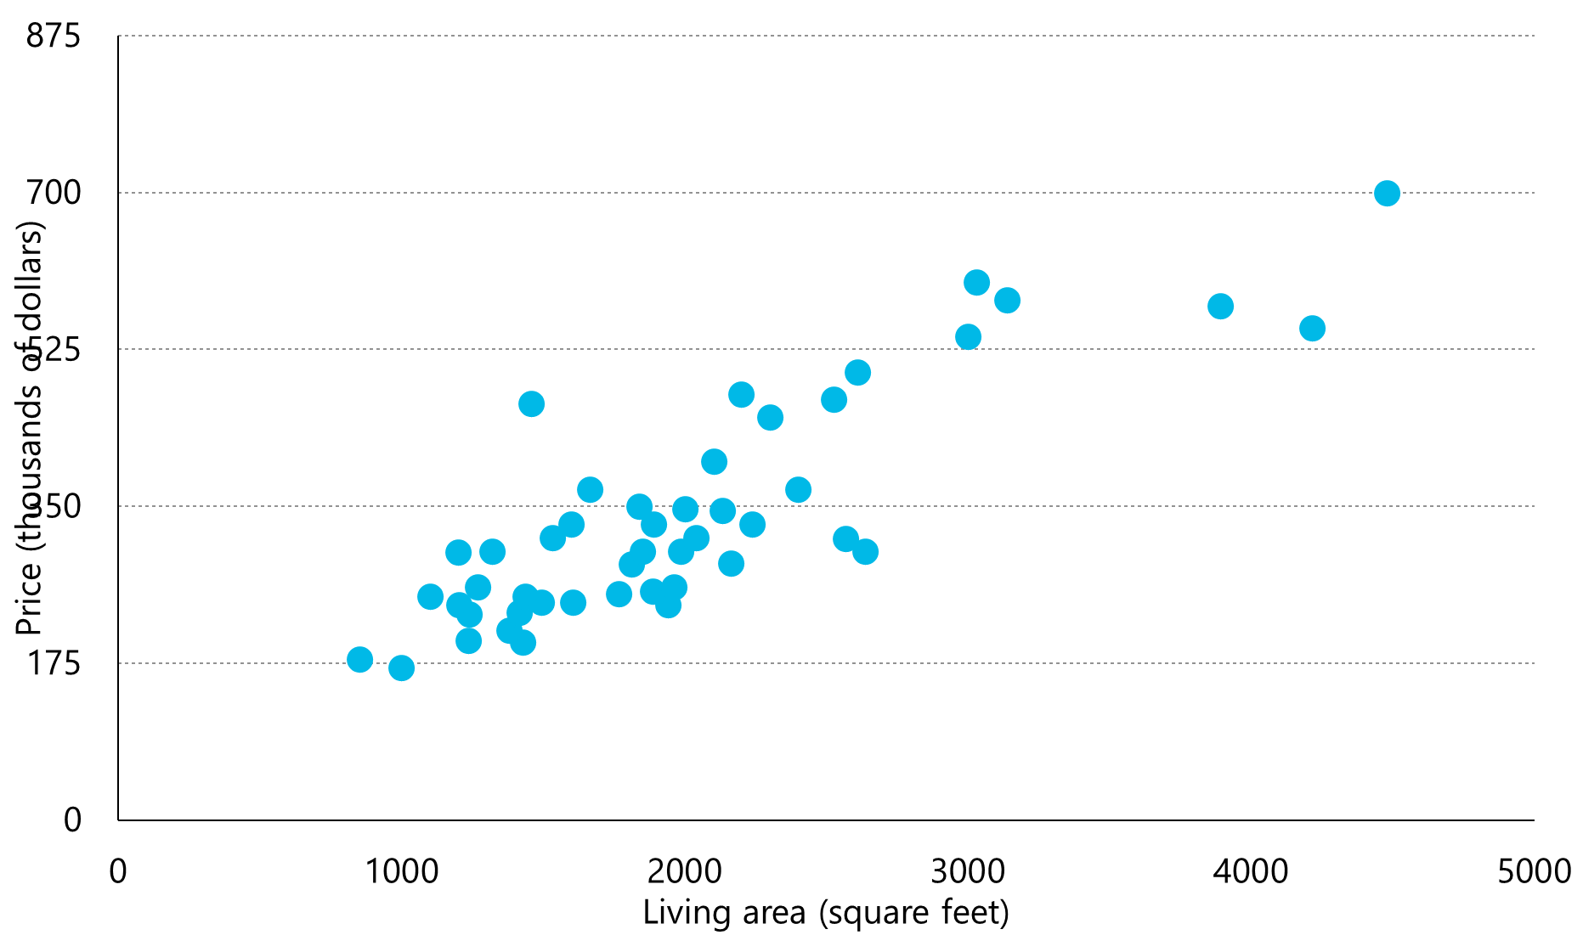
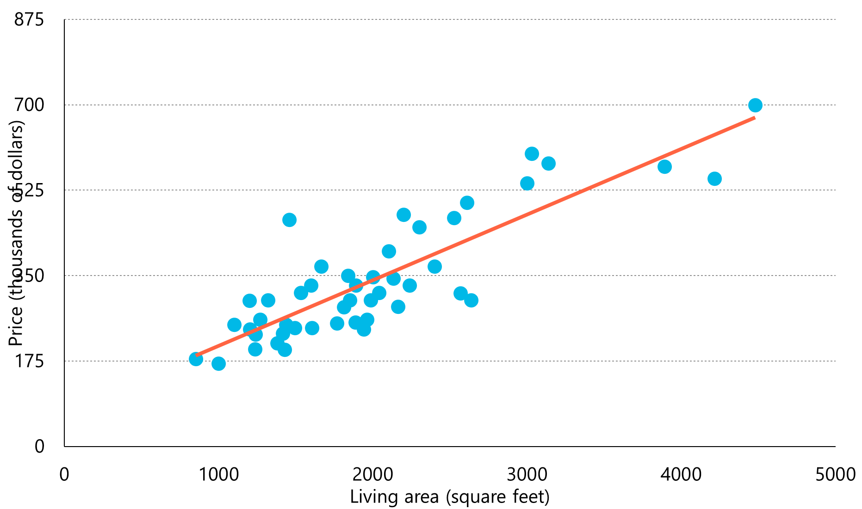
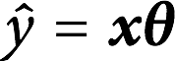
Machine Learning
10
Data
Learning Algorithm
Model
Linear regression

Slide 11
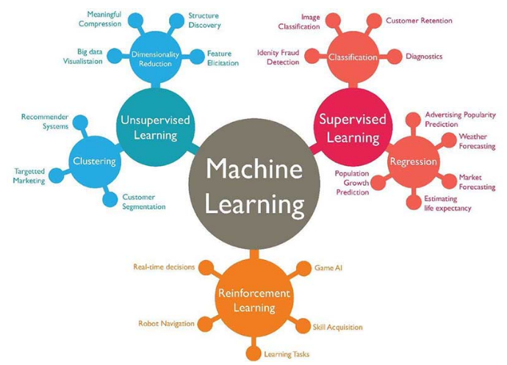
The Three Main Types of Machine Learning
11
Supervised learning
Given input-output examples f(X)=Y, learn the function f().
Unsupervised learning
Given input examples, find patterns such as clusters
Reinforcement learning
Select and execute an action, get feedback, update policy (what action to do in which state).
https://www.techleer.com/articles/203-machine-learning-algorithm-backbone-of-emerging-technologies/

Slide 12
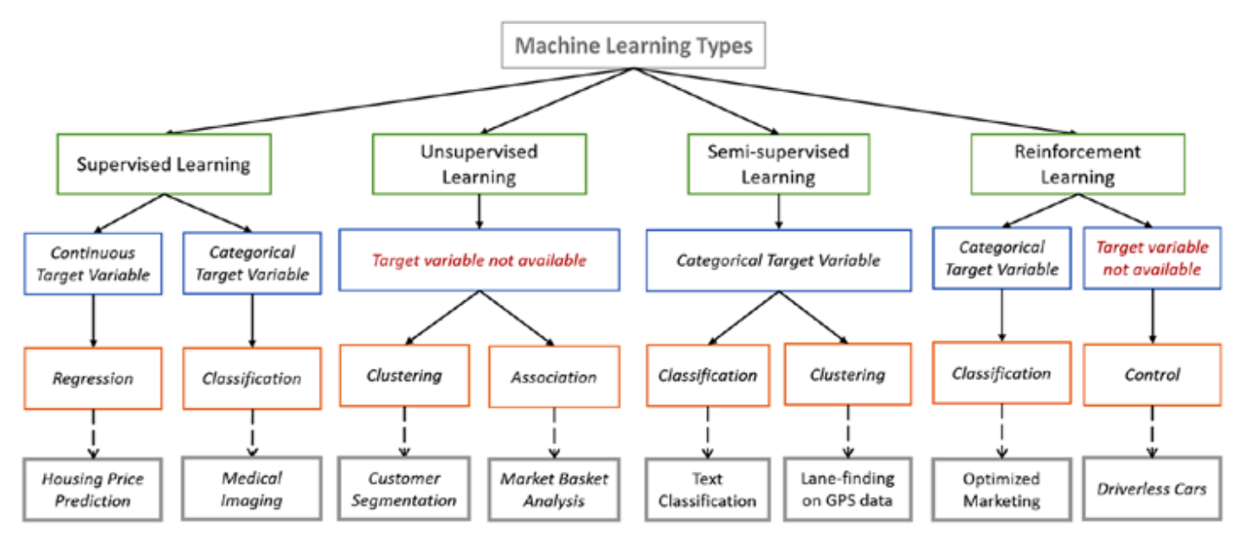

Slide 13


Slide 14
Supervised Learning at a Glance
In supervised learning
Agent has to learn from examples of correct behavior
Formally, learn an unknown function f(x) = y given examples of (x, y)
Performance metric: Loss (difference) between learned function and correct examples
Typically classified into:
Regression: Predict continuous valued output
Classification: Discrete valued output

Slide 15
Supervised Learning – Agent Perspective
Representation from agent perspective:
Performance Metric
state
Input (Sensors)
Reactive Agent
f(input) = output
e.g.
f(robot state) = action
World
Output (Actuators)
action
…but it can also be used as a component in other architectures

Slide 16
Reinforcement Learning at a Glance
In reinforcement learning
World may have state (e.g. position in maze) and be unknown (how does an action change the state)
In each step the agent is only given current state and reward instead of examples of correct behavior
Performance metric is sum of rewards over time
Combines learning with a planning problem
Agent has to plan a sequence of actions for good performance
The agent can even learn on its own if the reward signal can be mathematically defined
Notes:
Reinforcement Learning is inspired by psychology
Base on reward, learn on its own, based on failures

Slide 17
Reinforcement Learning at a Glance II
RL is based on a utility (reward) maximizing agent framework
Agent learns policy (plan function) to maximize reward over time
Either learn intermediate models of the effect of actions (next state, reward) from state s, or use model-free approaches
Performance Metric (reward over time)
state
Input (Sensors)
RL Agent
Learn policy(s) = action
Sometimes also:
R(state, action) = reward
f(state, action) = new state
Output (Actuators)
action
Real world examples – Robot Behavior, Game Playing (AlphaGo…)

Slide 18
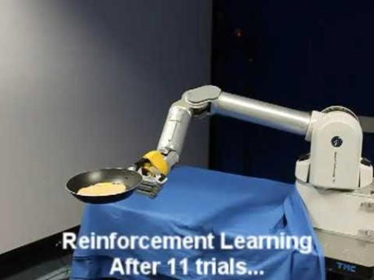
Supervised vs. Reinforcement Learning for Robot Behavior
Learning to flip pancakes, ”supervised” and reinforcement learning (reward not shown).
Notes:
Decision planning, good for RL, without good examples

Slide 19
Unsupervised Learning at a Glance
In unsupervised learning
Neither a correct answer/output, nor a reward is given
Task is to find some structure in the data
Performance metric is some reconstruction error of patterns compared to the input data distribution
Examples:
Clustering – When the data distribution is confined to lie in a small number of “clusters” we can find these and use them instead of the original representation, e.g. bigger recommender system (news, ads, etc.)
Dimensionality Reduction – Finding a suitable lower dimensional representation while preserving as much information as possible, e.g. image/video compression
Recent trend: Found structure can be used to generate new data (content)!
Notes:
Recommender system, find similarities

Slide 20
Unsupervised Learning at a glance II
Not directly applicable to the agent perspective as there is no clear way to encode a goal or behavior
However, the techniques can be useful as a preprocessing step in other learning approaches
If fewer dimensions or a few clusters can accurately describe the data, big computational wins can be made
It is also frequently used for visualization as smaller representations are easier to visualize on a computer screen
To keep this brief, we will not go into any further detail on unsupervised learning

Slide 21
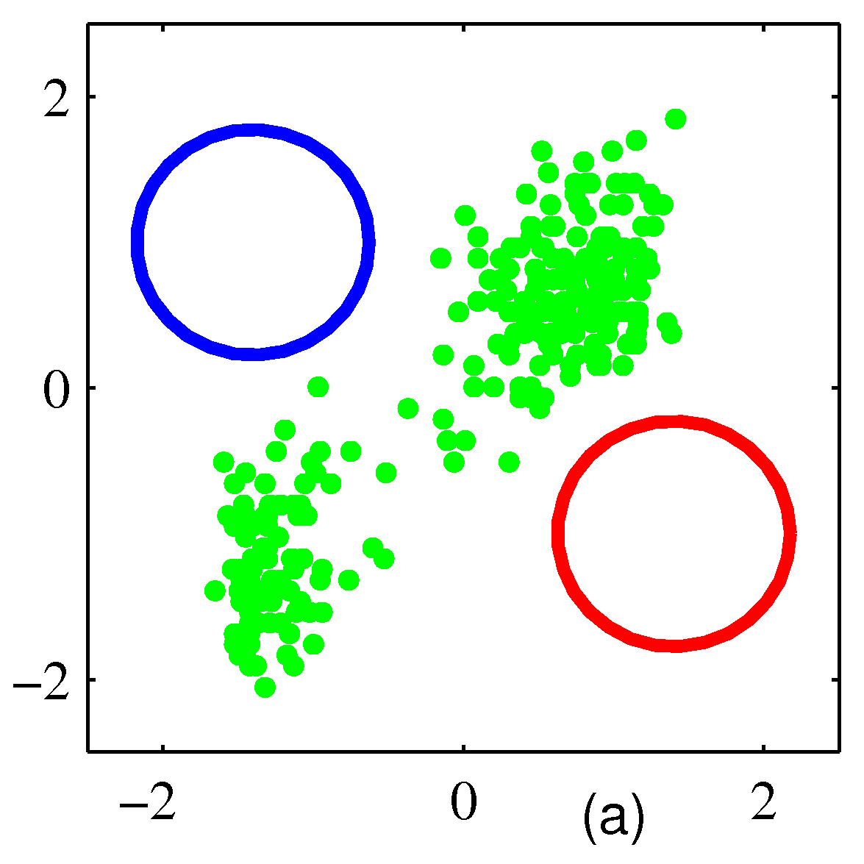
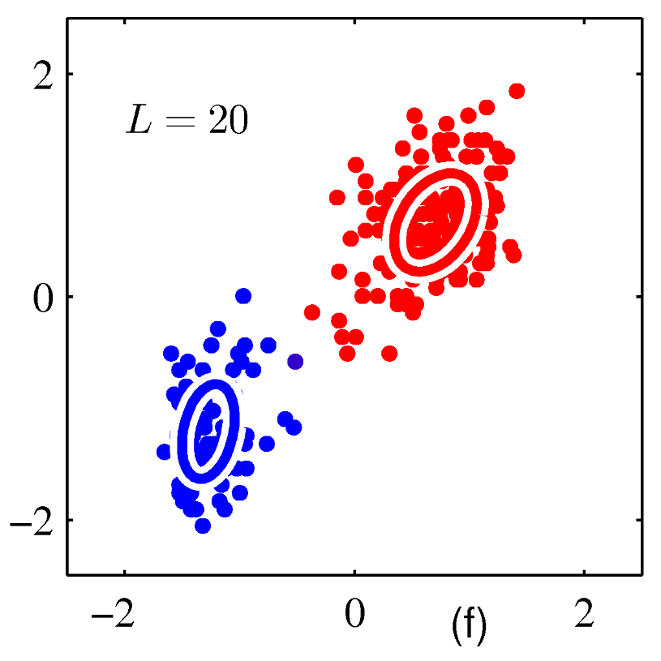
Unsupervised Learning Example: Clustering – Continuous Data
Two-dimensional continuous input
(Bishop, 2006)

Slide 22
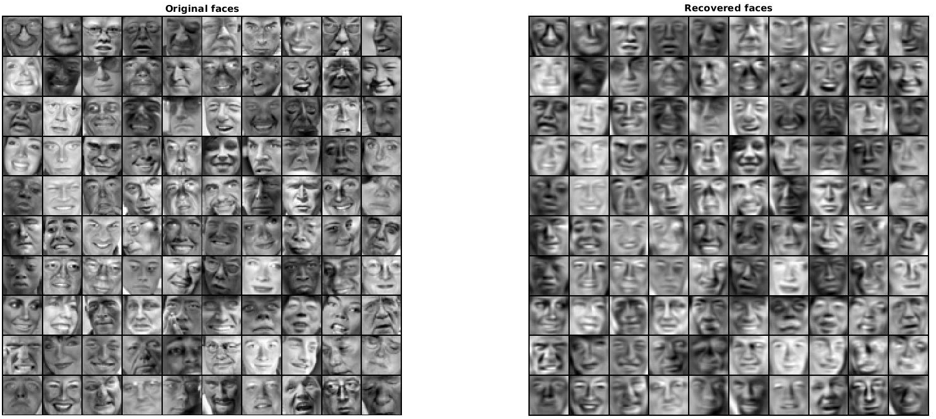
Unsupervised example
Original faces were down sampled to save space but still remain majority features.
Notes:
Recommender system, find similarities

Slide 23
Training, Validation, and Test Data
Training Data
Learning Algorithm
Model
Model
Validation Data
Metric

Slide 24

Precision and Recall
https://en.wikipedia.org/wiki/Precision_and_recall

Slide 25
Machine Learning Process
Training Data
Learning Algorithm
Validation Data
Test Data
Model

Slide 26
Training error and generalization error
We train a model by minimizing its error on the training data.
optimization
The training error is different from the generalization error – the expected value of the error on previously unseen inputs.
We can estimate the generalization error of a model by measuring its test error – the error on a held-out test set.
held-out = not seen during training

Slide 27
How can we hope to perform well on the test set?
Assumption 1: The examples in the training set and the test set are mutually independent.
Assumption 2: The examples in the training set and the test set are identically distributed.
sampled from the same data generating distribution
Under these assumptions, the expected test error is greater than or equal to the expected training error.

Slide 28
Underfitting and overfitting
Underfitting
The model is unable to obtain a sufficiently low error on the training set. The model is not expressive enough.
Overfitting
The gap between the training error and the test error is too large. The model is over-optimized for the training data.
memorises noise

Slide 29
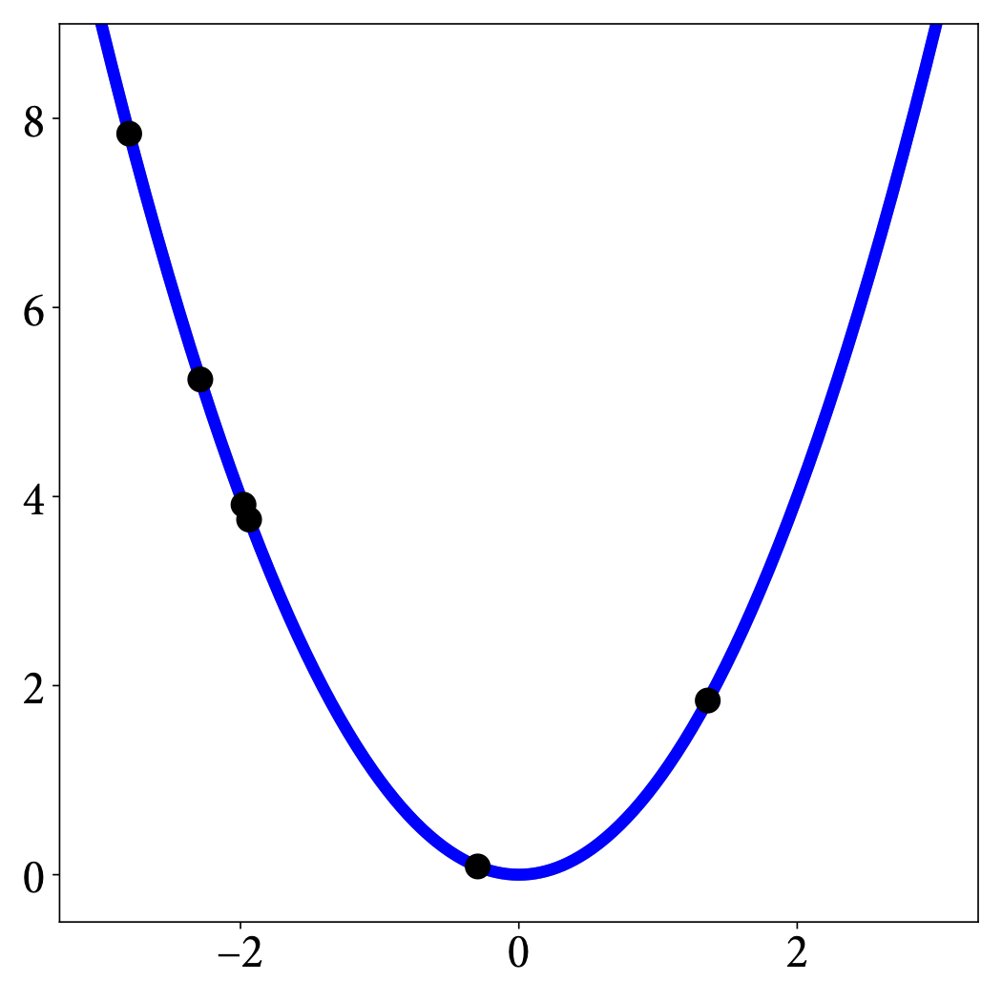
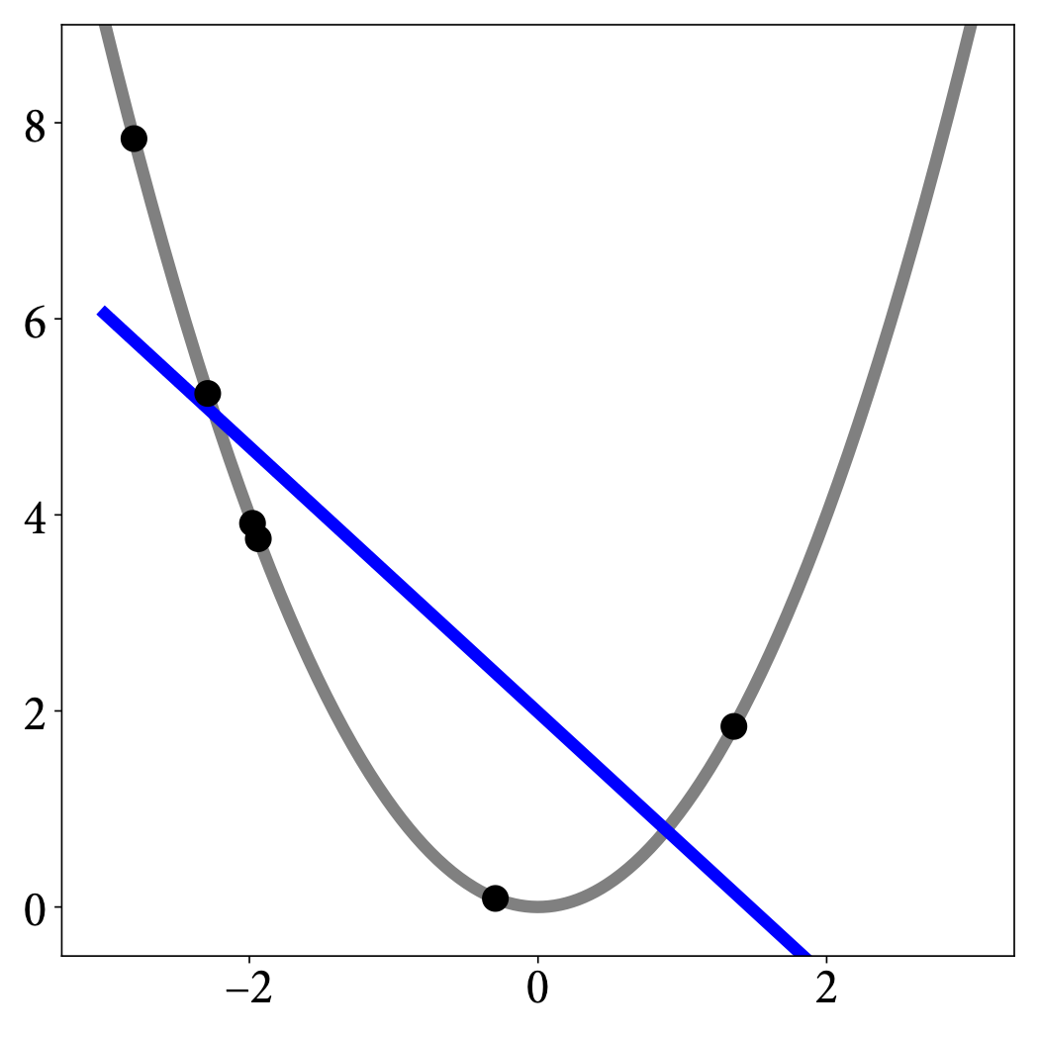
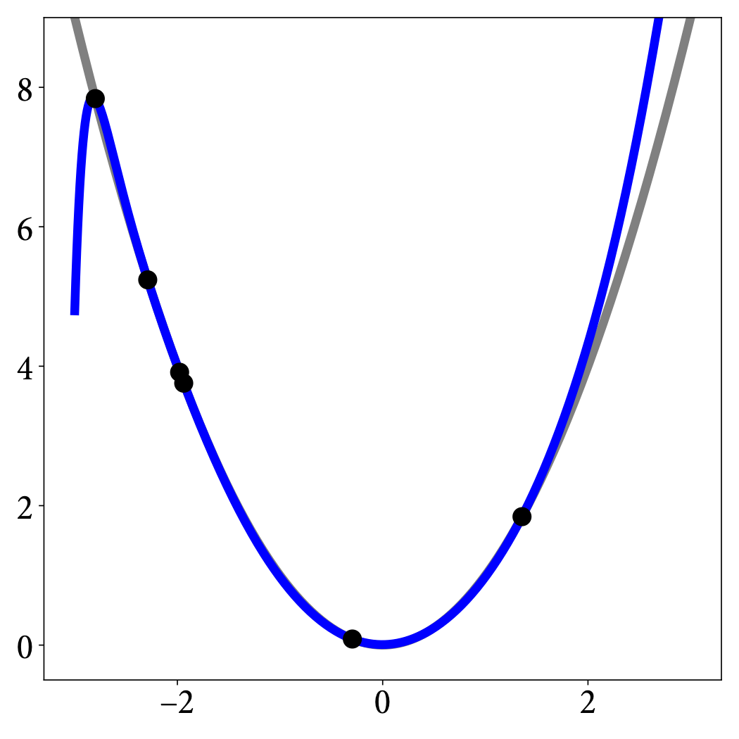
Underfitting and overfitting
appropriate
underfitting
overfitting
polynomial of degree 2
polynomial of degree 1
polynomial of degree 30

Slide 30
Relationship between model capacity and error
underfitting zone
overfitting zone
error
generalisation error
Source: GBC Figure 5.3
generalization gap
training error
model capacity

Slide 31
‘No free lunch’ theorems
Averaged over all possible data-generating distributions, every learning algorithm has the same generalisation error.
Wolpert (1996)
This means that there is no universal learning algorithm or absolute best learning algorithm.
We need to make assumptions about the kinds of data-generating distributions we encounter in practice.

Slide 32
Hyperparameters and validation sets
A setting of a machine learning algorithm that is not adapted by the algorithm itself is called a hyperparameter.
typical example: learning rate
Some settings need to be hyperparameters because adapting them during training would lead to overfitting.
such as parameters related to the model’s capacity
To tune hyperparameters, we need a separate validation set, or need to use cross-validation.

Slide 33
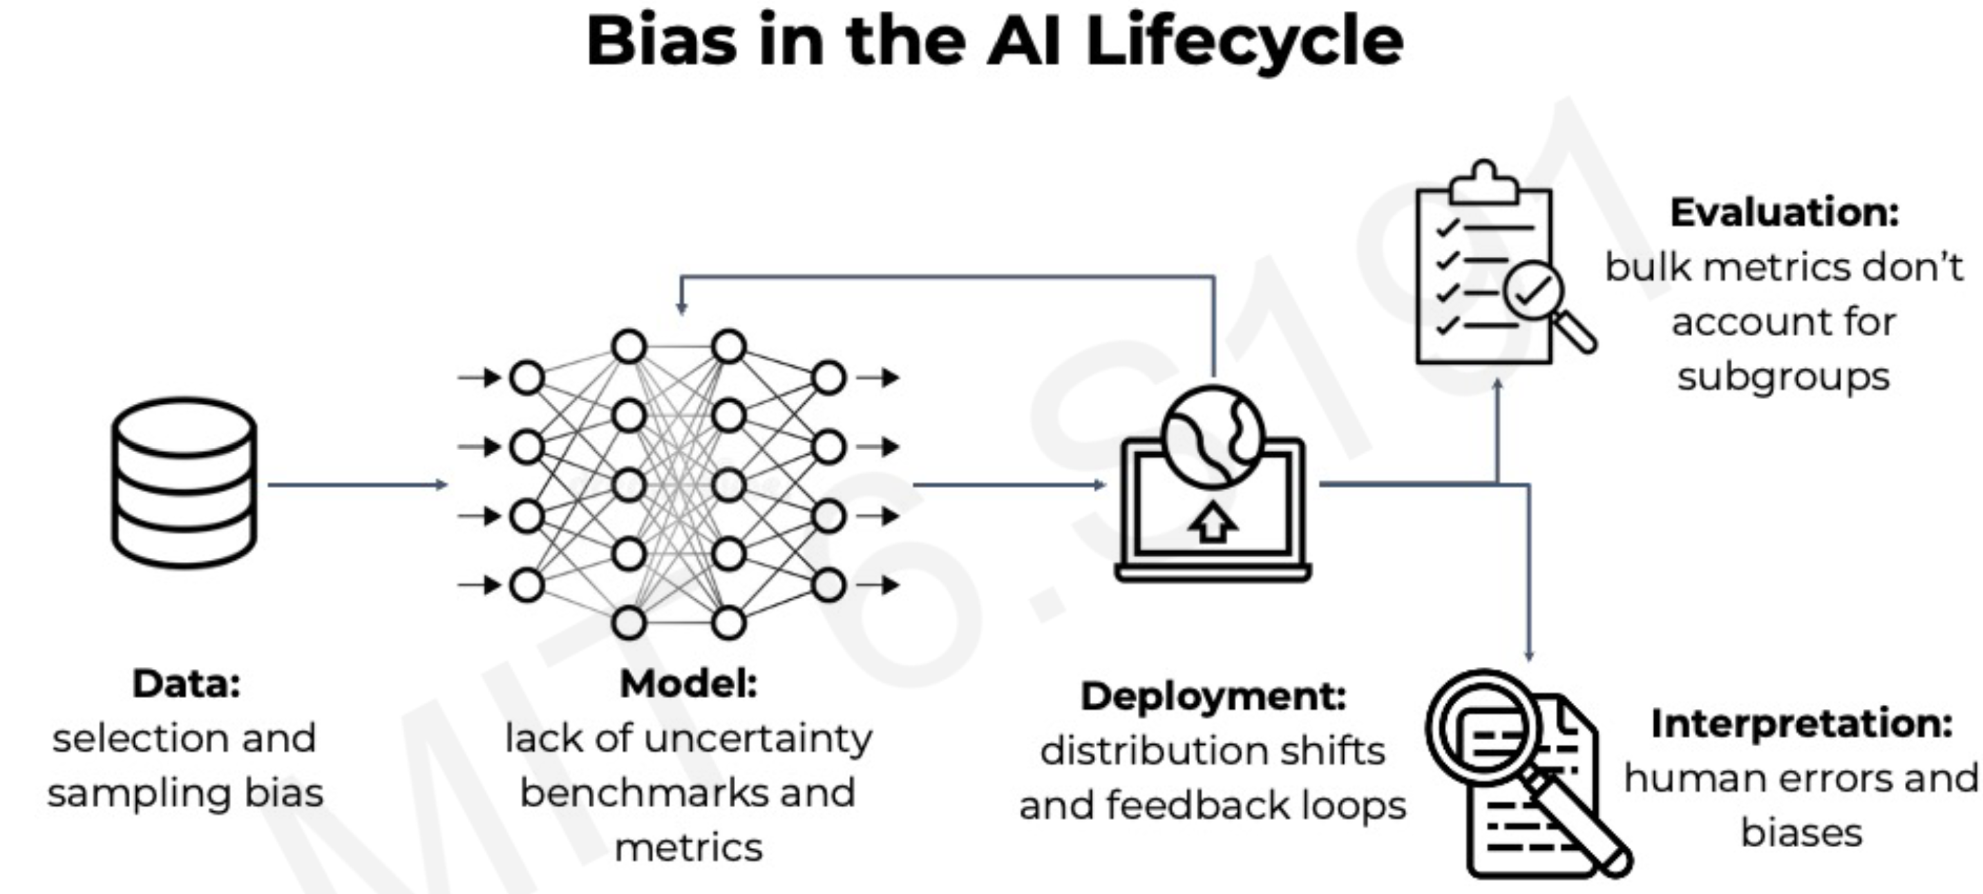

Slide 34
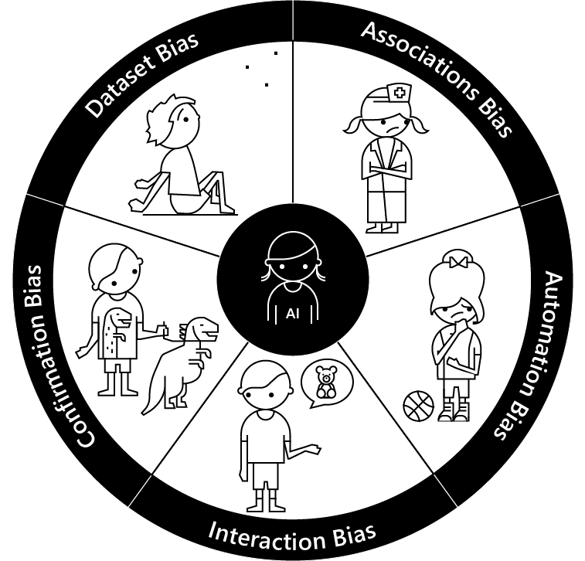
Bias
Dataset bias – When the data used to train machine learning models doesn’t represent the diversity of the customer base.
Association bias – When the data used to train a model reinforces and multiplies a cultural bias.
Automation bias – When automated decisions override social and cultural considerations.
Interaction bias – When humans tamper with AI and create biased results.
Confirmation bias – When oversimplified personalization makes biased assumptions for a group or an individual.
https://medium.com/microsoft-design/how-to-recognize-exclusion-in-ai-ec2d6d89f850

Slide 35
Supervised Learning

Slide 36
Outline of Supervised Learning
Today we will focus on Supervised Learning
Definition
Fundamentals: Features, Models, Loss (or cost) Functions, Training
Linear Models
Neural Networks
Trend: Deep Learning (more in next ML lecture)
Pitfalls and Limitations
Notes:
Focus a bit more on math

Slide 37
Formalizing Supervised Learning
Remember, in Supervised Learning:
Given tuples of training data consisting of (x,y) pairs
The objective is to learn to predict the output y’ for a new input x’
Formalized as searching for approximation to unknown function y = f(x), given N examples of x and y: (x₁,y₁), … ,(x_{n},y_{n})
Two major classes of supervised learning
Classification – Output are discrete category labels
Example: Detecting disease, y = “healthy” or “ill”
Regression – Output are numeric values
Example: Predicting temperature, y = 15.3 degrees
In either case, input data x_{i} could be vector valued and discrete, continuous or mixed. Example: x₁ = (12.5, “cat”, true).

Slide 38
Classical Supervised Learning in Practice
38
Can be seen as searching for an approximation to unknown function y = f(x) given N examples of x and y: (x₁,y₁), … ,(x_{n},y_{n})
Want the algorithm to generalize from training examples to new inputs x’, so that y’=f(x’) is “close” to the correct answer
An input “feature” vector x_{i} of examples is constructed by mathematically encoding relevant problem data
Examples of such (x_{i}, y_{i}) make up the training set
A model (or hypothesis) for f(x) is selected with some parameters
A loss function is selected that defines “closeness” to correct answers
The model is trained on the examples by searching for its parameters that minimize loss on the training set (i.e. are “close” to unknown f(x))

Slide 39
Feature Vector Construction
Want to learn f(x) = y given N examples of x and y: (x₁,y₁), … ,(x_{n},y_{n})
Most standard algorithms work on real number variables
If inputs x or outputs y contain categorical values like “book” or “car”, we need to encode them with numbers
With only two classes we get y in {0,1}, called binary classification
Classification into multiple classes can be reduced to a sequence of binary one-vs-all classifiers
The variables may also be structured as text, audio, image or video data
Finding a suitable feature representation can be non-trivial, but there are standard approaches for the common domains
With sufficient data, features can also be learned (deep learning, later…)

Slide 40

Feature Vector Example for Text - Bag of Words
One of the early successes of ML was learning spam filters
Spam classification example:
Each mail is an input, some mails are flagged as spam or not spam to create training examples.
Bag of Words Feature Vector:
Encode the existence of a fixed set of relevant key words in each mail as the feature vector.
Feature | Exists?
“Customer” | 1 (Yes)
“Dollar” | 0 (No)
“Fund” | 0
“Accept” | 1
“Bank” | 0
…. | …
x_{i} = words_{i} =
y_{i} = 1 (spam) or 0 (not spam)
Simply learn f(x)=y using suitable classifier!

Slide 41
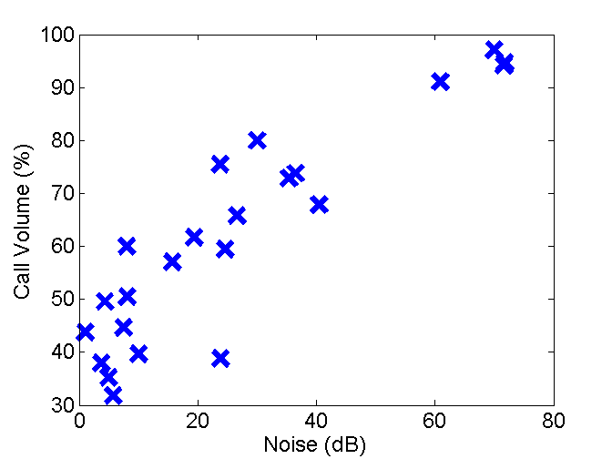
Selecting Models: Linear Regression Example
Construct a feature vector x_{i} to be used with examples of y_{i}
Select a model and train it on examples (search for a good approximation to the unknown function)
Fictional example: Smartphone app that learns desired ring volume based on examples of volume and background noise level
Feature vector x_{i} = (Noise dB), y_{i} = (Volume %)
Select the familiy of linear functions:
Train the algorithm by searching for a line that fits the data well
…but how does ”training” really work?

Slide 42
Training a Learning Algorithm
Feature vector x_{i} = (Noise in dB), outputs y_{i} = (Volume %)
Recap: Want to find approximation h(x) to the unknown function f(x)
As an example, let it to be the family of linear functions:
The model has two parameters: (line slope and offset)
How do we find parameters that result in a good approximation h?
Three poor linear hypotheses

Slide 43
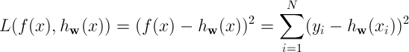
Training a Learning Algorithm – Loss Functions
How do we find parameters w that result in a good approximation ?
Need a performance metric for function approximations of unknown f(x)
Loss functions
Minimize deviation against the N example data points from f(x)
For regression one common choice is a sum square loss function:
Why square loss? Negative difference is as bad as positive
Search in continuous domains like w is known as optimization
(if unfamiliar, see Ch4.2 Local Search in Continuous Spaces in course book AI: A Modern Approach)

Slide 44
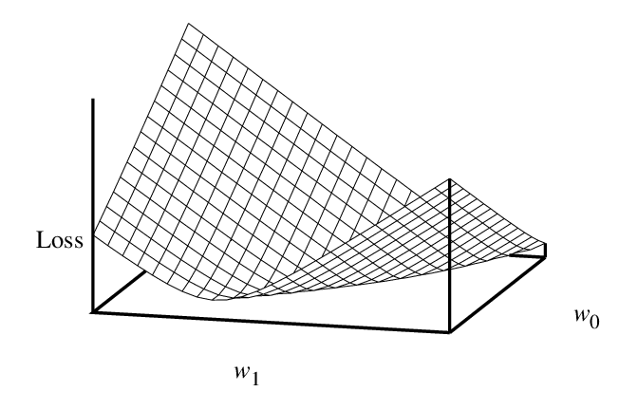
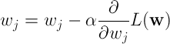
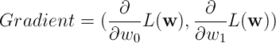
Training a Learning Algorithm – Optimization
How do we find parameters w that minimize the loss?
Optimization approaches iteratively move in the direction that decreases the loss function L(w)
Simple and popular approach: gradient descent
Negative gradient points down in loss function
Step size (learning rate)

Slide 45
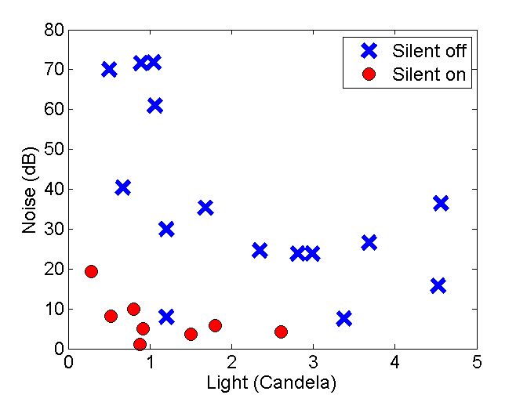
What about categorical outputs (classification)?
Construct a feature vector x_{i} to be used with examples of y_{i}
Select a model and train it on examples (search for a good approximation to the unknown function)
Fictional example: Smartphone app that learns if silent mode should be on/off at different levels of background noise and light
Feature vector x_{i} = (Noise, Light level), y_{i} = {“silent on”, “silent off”}
Again, can select the familiy of linear functions. However, now outputs y have to be transformed to the interval [0,1]
Can classify new inputs according to how close output is to 0 or 1.
For linear models, the decision boundary will still be a straight line.

Slide 46
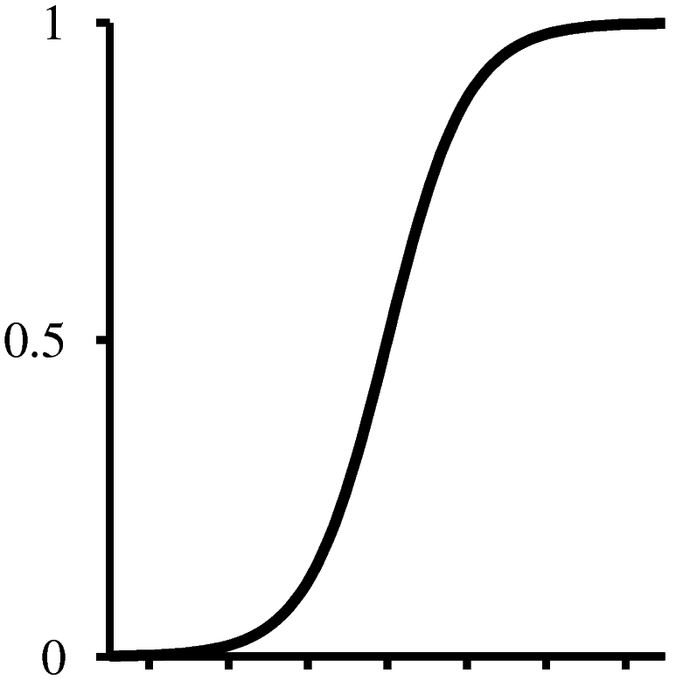
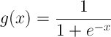
Classifier Training – Loss Functions II
How to transform standard models to classification?
Squared error does not make sense when target output discrete set {0,1}
Could use custom loss functions for classification
Minimize number of missclassifications (unsmooth w.r.t. parameter changes)
Maximize information gain (used in decision trees, see book)
However, requires specialized parameter search methods
Instead: Make outputs probabilities [0,1] by squashing predicted numeric outputs via sigmoid (”S”)
Sigmoid functions allow us to do use any regression model with binary classification by def. Pr(y=”1”|X) = g(model(x))
Where g is ”logistic” sigmoid :
For >2 classes, use soft-max (see book)
Classify as ”1”
Classify as ”0”
-∞
∞

Slide 47
Training a Learning Algorithm – Limitations
Limitations
Local optimization of loss is greedy – Gets stuck in local minima unless the loss function is convex w.r.t. w, i.e. there is only one minima.
Linear models are convex, however most more advanced models are vulnerable to getting stuck in local minima.
Care should be taken when training such models by using for example random restarts and picking the least bad minima.
If we happen to start in red area, optimization will get stuck in a bad local minima!

Slide 48
Linear Models in Summary
Advantages
Linear algorithms are simple and computationally efficient
For both regression and classification
Training them is a convex optimization problem, i.e. one is guaranteed to find the best hypothesis in the space of linear hypothesis
Can be extended by non-linear feature transformations
Disadvantages
The hypothesis space is very restricted, it cannot handle non-linear relations well
Still widely used in applications
Recommender Systems – Initial Netflix Cinematch was a linear regression, before their $1 million competition to improve it. Rather simple and are appropriate for small systems.
Often a good place to start...
At the core of many big internet services. Ad systems at Twitter, Facebook, Google etc...
Notes:
Also UL, find categories to make predictions

Slide 49
What about models with uncertainty?
Supervised Learning:
Mathematically, can be seen as finding an approximation to an unknown function y = f(x) given N examples of x and y
Two perspectives:
Deterministic Models
Search for a suitable function y = h(x)
What we have looked at so far, the most common approach
Example: In classification something may be either A or B, never in-between, regression gives an exact answer like 15.3
Probabilistic Models
Search for a suitable probability distribution like P(Y|X)
When we also want to predict the uncertainty
Example: P(Y=“Healthy”|X) = 0.7 and P(Y=“Cancer”|X) = 0.3
In a spam filter we might prefer to get a spam too many than to trash that important mail from your boss…

Slide 50
Model Selection – Choosing Between Models
In conclusion, we want to avoid unnecessarily complex models
This is a fairly general concept throughout science and is often referred to as Ockham’s Razor:
“Pluralitas non est ponenda sine necessitate”
-Willian of Ockham
“Everything should be kept as simple as possible, but no simpler.”
-Albert Einstein (paraphrased)
There are several mathematically principled ways to penalize model complexity during training, e.g. regularization, which we will not cover here.
A simple approach is to use a separate validation set with examples that are only used for evaluating models of different complexity.
Notes:
Quickly go through

Slide 51
Model Selection – Hold-out Validation
This is called a hold-out validation set as we keep the data away from the training phase
Measuring performance (loss) on such a validation set is a better metric of actual generalization error to unseen examples
With the validation set we can compare models of different complexity to select the one which generalizes best, for model selection.
Examples could be polynomial models of different order, the number of neurons or layers in an ANN etc.
Given example data:
Training Set
Validation Set

Slide 52
Measuring Final Generalization Error
We have seen that having a validation set will lead to a more accurate estimation of generalization error to use for model selection
However, by extensively using the validation set for model selection we can also contaminate it (overfitting model against the data in the validation set)
To combat this one usually sets aside a separate test set
This test set is not used during training or model selection
It is basically locked away in a safe and only brought out in the end to get a fair estimate of final generalization error
Given example data:
Training Set
Validation Set
Test Set

Slide 53
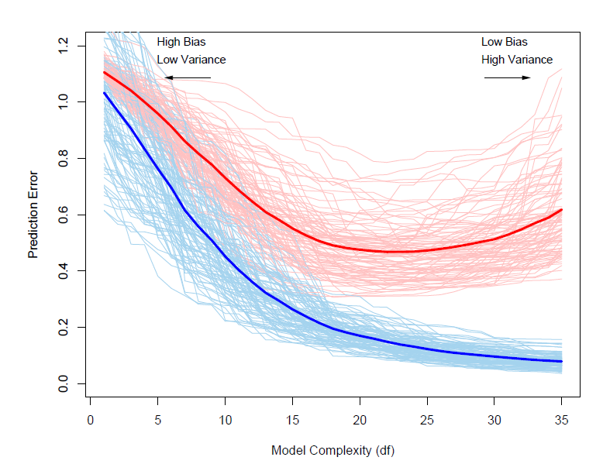
Model Selection – Selection Strategy
As the number of parameters increases, the size of the hypothesis space also increases, allowing a better fit to training data
However, at some point it is sufficiently flexible to capture the underlying patterns. Any more will just capture noise, leading to worse generalization to new examples!
Do we need to train and test many models of different complexity?
Various tricks to avoid this
Example: Prediction error vs. model complexity over many (simulated) data sets. (Hastie et al., 2009)
Best choice
Overfitting
Red: Validation set (generalization) error
Blue: Training set error

Slide 54
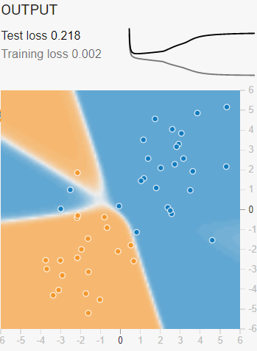
Early Stopping: Model Complexity Trick with Neural Networks
Training neural networks tends to progress from simple functions to more complex ones
This comes from initializing the parameter values w close to zero
Remember, a neuron’s output = g(w*x)
Common activation functions g (e.g. sigmoid) are linear around zero
This makes the NN effectively ”start out” as a linear model
Early stopping NN trick: Can make a model complexity vs. validation loss curve while training, stop when validation error starts increasing
Exercise: Back to the NN demo app
Observe ”test loss” plot
Reset network
Train again, but keep an eye on test loss
Try to pause at low test loss
Can adjust ”learning rate”
Stop training here!

